Slide 1
THE CREATIVE JOURNEY STARTS HERE

Slide 2
AGENDA
QUESTIONS and NEXT STEPS
WHAT
WHO
WHY
HOW

Slide 3
What is Destination Imagination?
Self-Confidence
Destination Imagination (DI) is an educational nonprofit that prepares learners for a future that is rapidly evolving.
We do this through a project-based learning experience that applies the creative process across seven different Challenge types.
Our participants learn 21st century skills and more.
Problem Solving
Team Building
Creative & Critical Thinking
Perseverance
Project Management
Risk Taking
WHAT

Slide 4
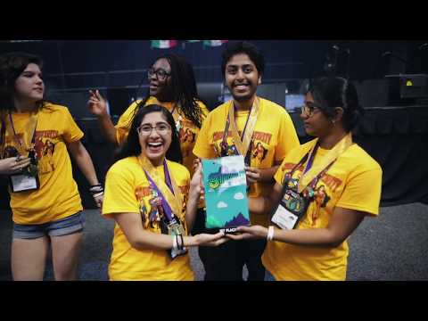
What is Destination Imagination?
WHAT

Slide 5
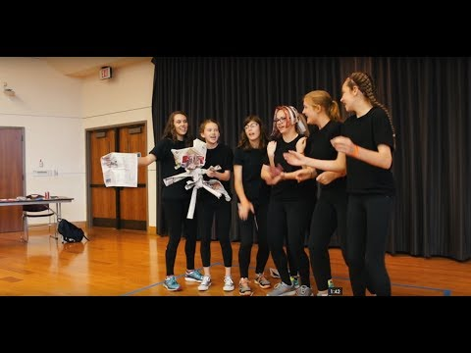
What is Destination Imagination?
WHAT

Slide 6
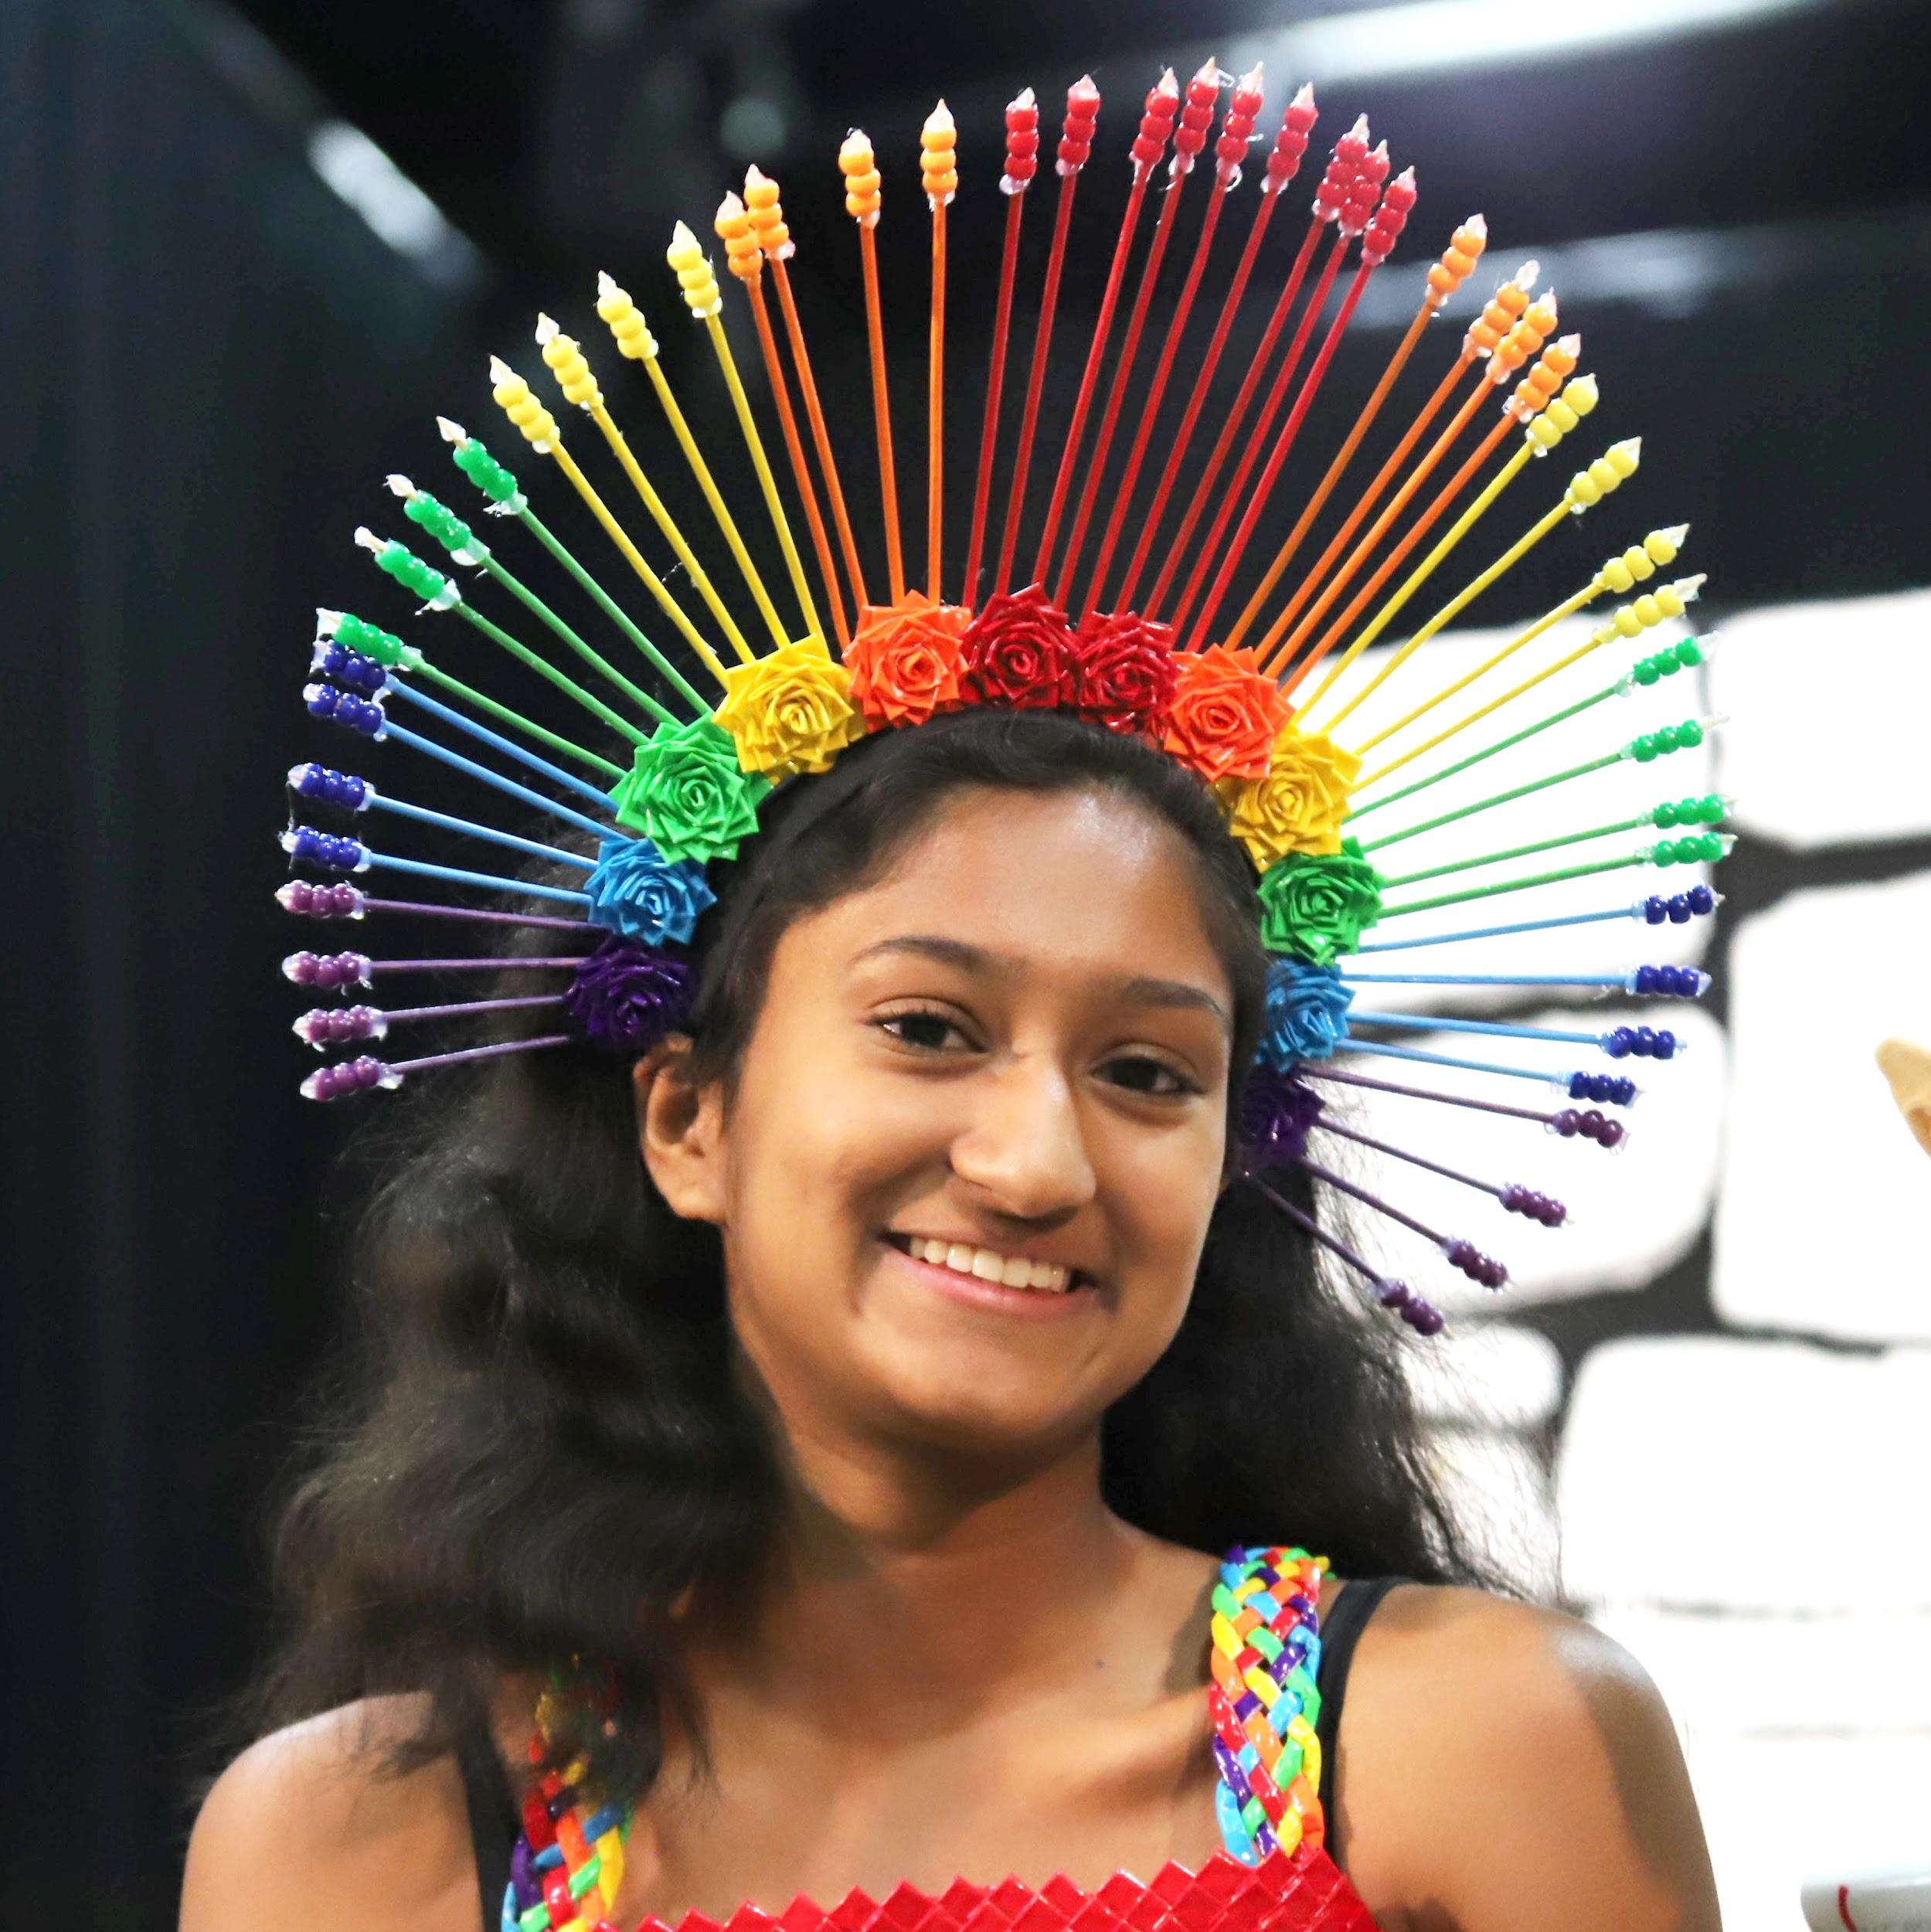
The Challenge Experience
Each year, more than 150,000 students across the U.S. and in 30-plus countries participate in the Destination Imagination Team Challenge Experience.
The Challenge Experience includes six competitive Challenges rooted in STEAM (science, technology, engineering, arts, and mathematics) concepts.
Our Challenges are developed annually with the help of educators, subject matter experts, and qualified volunteers.
Each Challenge encourages students to explore their passions, discover their own talents and abilities, and learn new skills.
WHAT

Slide 7
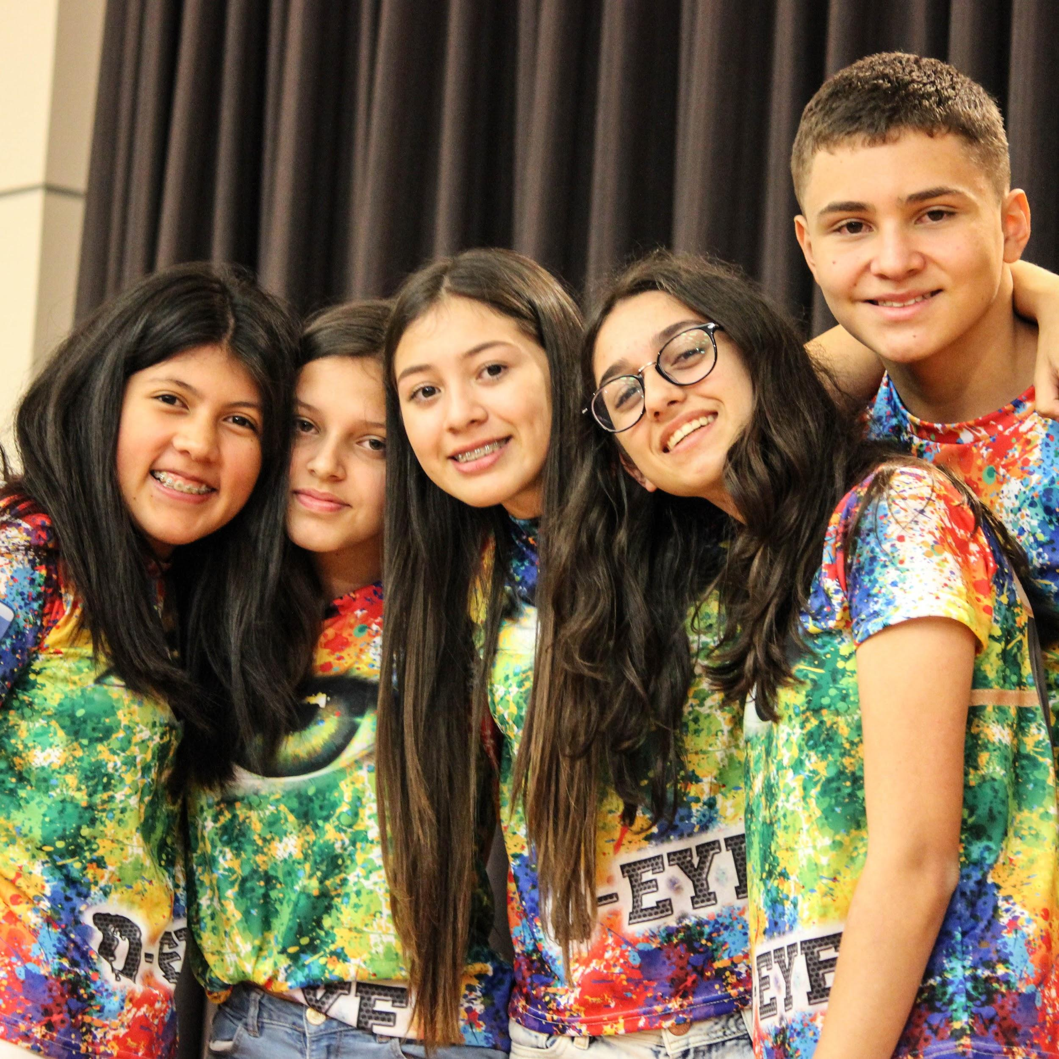
The Challenge Experience
Open to all kindergarten through university level students worldwide.
Student teams of up to seven members select their Challenge and work together to develop a solution.
Each team has at least one Team Manager to help keep the team on track, but does not assist or interfere with the team’s solution. This volunteer role is typically filled by a parent, teacher, or community member.
Teams showcase and celebrate their innovative Challenge solutions at a local tournament.
WHAT

Slide 8
TEAM CHALLENGE CATEGORIES
https://www.destinationimagination.org/challenge-program/2018-19-challenge-previews/
WHAT

Slide 9
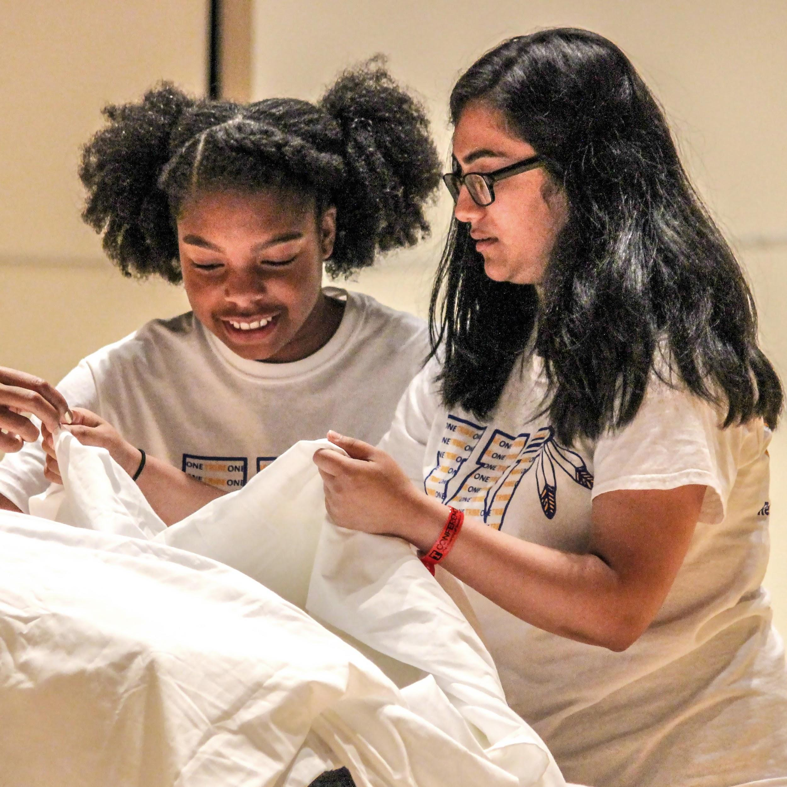
INSTANT
CHALLENGE
Instant Challenges require teams to engage in quick, creative, and critical thinking.
At a tournament, a team receives an Instant Challenge and the materials with which to solve it. Team members must think on their feet by applying appropriate skills to produce a solution in a period of just five to eight minutes.
Instant Challenges are kept confidential until the day of the tournament.
WHAT

Slide 10
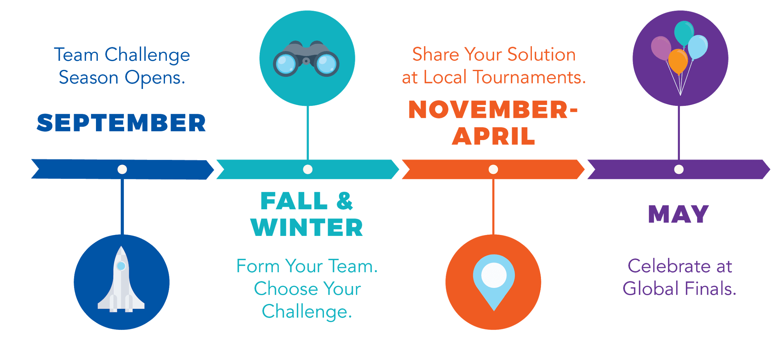
Tournament Season at a Glance
Teams typically spend two to four months planning, developing, and practicing their Challenge solutions.
They exhibit their creativity and innovation by showcasing their Challenge solutions in front of live audiences at local tournaments.
2019
January 26: Super Saturday in Bossier City
February 2 or 9: Possible Super Saturday in Lafayette or Baton Rouge (TBD after consultation with south LA team managers and University of Louisiana at Lafayette)
February 23: State Tournament in Bossier City
Please note that Southern Hemisphere DI teams will have an adjusted timeline.
WHAT

Slide 11
GLOBAL FINALS
Teams advancing past Regional (local) and Affiliate (state/country) Tournaments are invited to Global Finals—the world’s largest celebration of creativity.
Global Finals by the Numbers:
Four days of Challenge Presentations and special events
1,400 teams and 17,000 attendees from around the world
Global Finals will be held in Kansas City, Missouri
(May 22-25, 2019)
WHAT

Slide 12
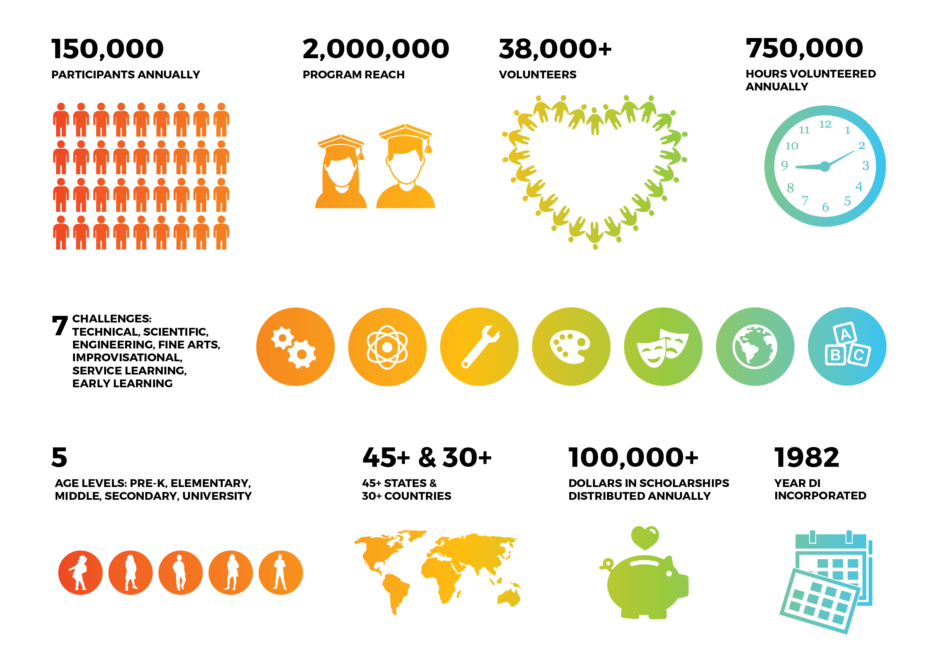
DI
COMMUNITY
WHO

Slide 13
Who does Destination Imagination?
STUDENTS
TEACHERS & ADMINISTRATORS
VOLUNTEERS
PARENTS & GUARDIANS
ALUMNI
WHO

Slide 14
The Workforce of the Future
Though we don’t know what these jobs will look like, we know the skills that will be needed — skills that DI helps students gain, including creative problem solving, critical thinking, and project management.
60% of CEOs polled cited creativity as the most important leadership quality, compared with 52% for integrity and 35% for global thinking.
– IBM Global CEO Study
The demand for highly-skilled workers will hit 123 million by 2020, but there will only be 50 million qualified people to fill these roles.
– AT&T
65% of today’s students will be employed in jobs that have yet to be invented.
– U.S. Department of Labor
WHY

Slide 15
INSTANT
CHALLENGE
Golf Bridge
Let’s try a Global Finals Instant Challenge
WHAT

Slide 16
INSTANT
CHALLENGE
Golf Ball Bridge
Challenge
Build a bridge between two chairs 1 foot apart that will support the weight of a golf ball for 10 seconds.
Time
You have 5 minutes to use your teamwork, creativity, and innovation skills to build the structure with the materials provided. You will then have one chance to place your golf ball for score.
The Scene
You have been asked to build a new bridge for a small-scale Indiana Jones movie for mice. The bridge will be used to roll across a “boulder” chasing Mini-ana Jones. The structure must be freestanding on the two chairs and must hold the weight of a golf ball for at least 10 seconds so that the “boulder” can get across the bridge without it breaking. After the 5-minute build time, the golf ball will be placed on the bridge for score.
Materials
1 paper plate, 1 rubberband, 1 clothespin, 2 jumbo paper-clips, 3ft of string, 1 golf ball
WHAT

Slide 17
Destination Imagination is based on a unique pedagogy and the need for 21st Century Skills
No Interference
Team members are responsible for their solutions
Resource Awareness
Teaching to be aware of what’s available and utilizing those resources wisely
Clarifying Questions
Explore options and pushing the limits with questions
Rapid Ideation and Implementation
Problem-Solving at it’s finest
Authentic Self-Expression
Safe space for uniqueness while collaborating and encouraging each other
WHY

Slide 18
Team Manager
It’s important to remember that the challenges and solutions are 100% owned by the team members. Our role as Team Managers is to encourage and foster creativity and help them celebrate their strengths and talents.
Creativity Catalyst
Educator
Challenge Expert
Chief Safety Officer
Facilitator
Interference Deflector
WHY

Slide 19
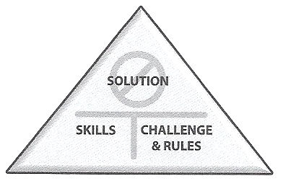
What is Interference?
Self-Confidence
Any creative or physical interruption of the students solving their own challenge.
Encourage students to learn skills and develop their own ideas.
Ownership belongs with the students.
Problem Solving
Team Building
Creative & Critical Thinking
Perseverance
Project Management
Risk Taking
WHAT

Slide 20
Why
INSTANT
CHALLENGE?
Instant Challenges require teams to engage in quick, creative, and critical thinking. At a tournament, a team will receive an Instant Challenge and the materials with which to solve it. The team members must think on their feet by applying appropriate skills to produce a solution in a period of just five to eight minutes. Instant Challenges are kept confidential until the day of the tournament.
Makes up 25% of the team’s score at tournament
Rapid Pace provides a low-risk opportunity for tremendous growth
Teach the skills necessary for Central Challenge
Task-Based, Performance-Based, or both
WHAT

Slide 21
Questions AND Next Steps
ELIGIBILITY:
14 slots
Increased Interest: Try outs will be held on October 12th. InstaChallenge: Golf Ball Bridge
Teacher Recommendation
SCHOOL:
Purchased two team challenges
Provide in school and after school opportunities to practice
Fundraising
STUDENTS:
Focused, persistent, committed, solution seeking, and a team player
PARENTS:
Stay connected, and committed
Fundraising
Thank you! For additional information, please contact:
HOW

Slide 22
Thank you! For additional information, please contact: Katrice Hall at 225-926-5421
Check out https://khalltech.weebly.com/ for up to date DI information.
REMIND: Text this message @d4k6g6k to 81010
HOW

